Slide 1
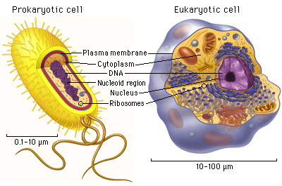
Prokaryotic Cells Vs. Eukaryotic Cells

Slide 2
Cells
The lowest level of organisation is cells
All cells fall into one of the two major classifications of either prokaryotic or eukaryotic.

Slide 4
What’s the difference between prokaryotes and eukaryotes?
Prokaryotic cells were here first and for billions of years were the only form of life on Earth. All prokaryotic organisms are unicellular
Eukaryotic cells appeared on earth long after prokaryotic cells but they are much more advanced. Eukaryotic organisms unlike prokaryotic can be unicellular or multicellular.

Slide 5
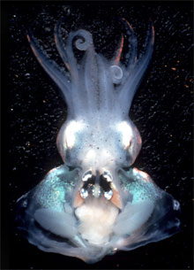

Slide 6
Glow in the dark squid… how does it do that?

Slide 7
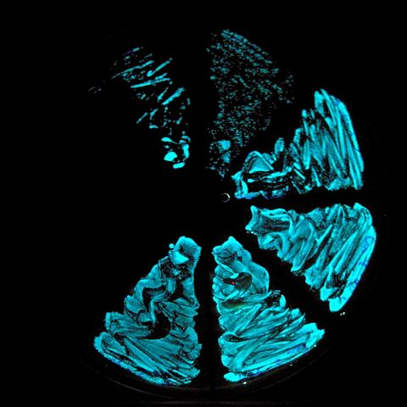
Vibrio fischeri
Glow in the dark bacteria
Helps it survive in the ocean
Lives in fish and other marine life

Slide 8
Let’s Take a Look at the Characteristics of Prokaryotes
Prokaryotes are the simplest type of cell.
Oldest type of cell appeared about four billion years ago.
Prokaryotes are the largest group of organisms
Prokaryotes unicellular organisms that are found in all environments.

Slide 9
Let’s Take a Look at the Characteristics of Prokaryotes
Prokaryotes do not have a nuclear membrane . Their circular shaped genetic material dispersed throughout cytoplasm.
Prokaryotes do not have membrane-bound organelles .
Prokaryotes have a simple internal structure.
Prokaryotes are smaller in size when compared to Eukaryotes.

Slide 10
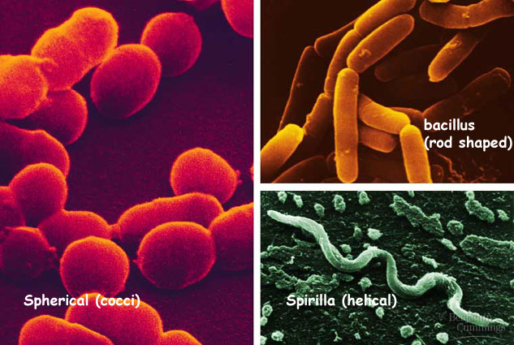
Shapes of Prokaryotes
Cocci = spherical (round)
Bacillus = (rod shaped)
Spirilla = helical (spiral)

Slide 11
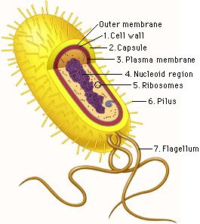
What do prokaryotic cell look like?

Slide 12
Now let’s take a look at the characteristics of eukaryotes
Eukaryotic cells appeared approximately one billion years ago
Eukaryotes are generally more advanced than prokaryotes
Nuclear membrane surrounds linear genetic material (DNA)

Slide 13
Is there more? Yes!!!
Unlike prokaryotes, eukaryotes have several different parts.
Eukaryote’s organelles have coverings known as membranes.
Eukaryotes have a complex internal structure.
Eukaryotes are larger than prokaryotes in size .

Slide 14
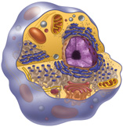
What do eukaryotic cells look like?
Mitochondria
Nucleus
Cytoplasm
Golgi Complex
Endoplasmic Reticulum
Cell Membrane

Slide 15
How do the differences line up?
Prokaryotes
Organelles lack a membrane
Ribosomes are the only organelles
Genetic material floats in the cytoplasm (DNA and RNA)
Eukaryotes
Organelles covered by a membrane
Multiple organelles including ribosomes
Membrane covered Genetic material

Slide 16
How do the differences line up?
Prokaryotes
Circular DNA
Unicellular
Cells are smaller in size
Has larger number of organisms
Eukaryotes
Linear DNA
May be multi-cellular or unicellular
Cells are larger in size
Has smaller number of organisms

Slide 17
How do the differences line up?
Prokaryotes
Appeared 4 billion years ago
Eukaryotes
Appeared 1 billion years ago

Slide 18
How do the similarities line up?
Lets See!!!
Both types of cells have cell membranes (outer covering of the cell)
Both types of cells have ribosomes
Both types of cells have DNA
Both types of cells have a liquid environment known as the cytoplasm

Slide 19
Your turn:
Make a Venn Diagram outlining the similarities and differences between prokaryotes and eukaryotes
You may use your book and/or consult your teammate

